Slide 1

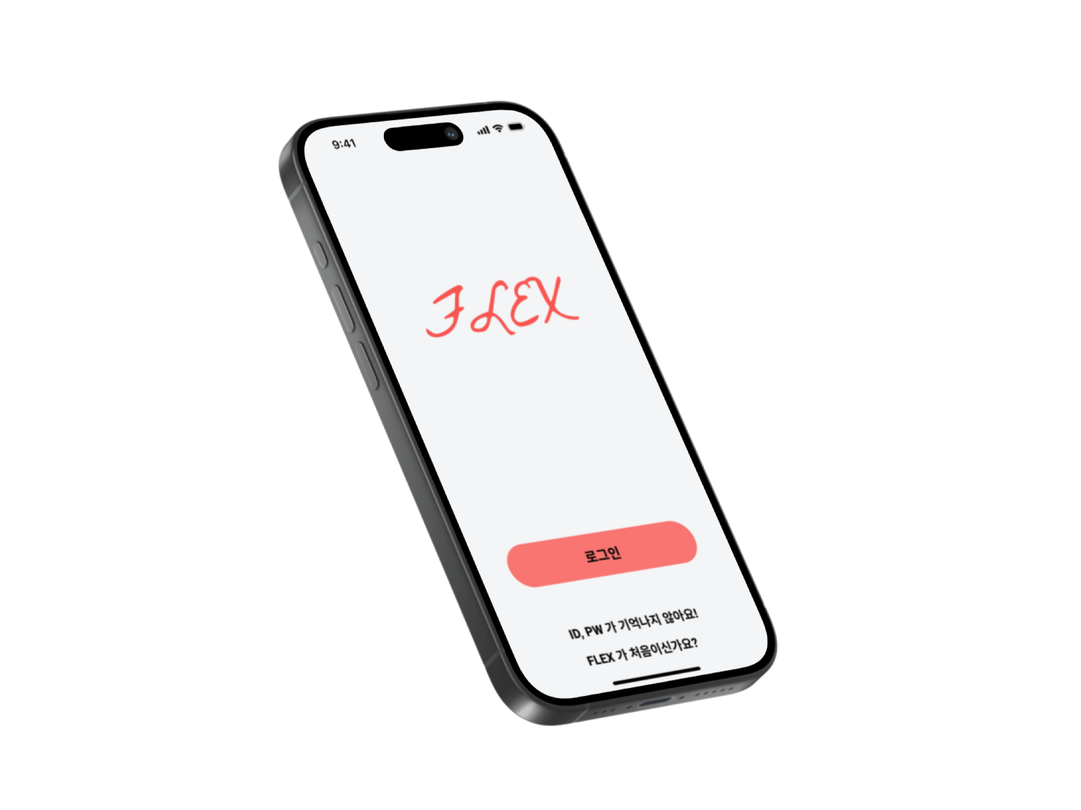








FLEX
Your own Food & Workout assistant

Slide 2
TABLE OF CONTENTS
01
02
03
04
05
06
Overall Progress
Completed tasks
Technical background
Project Challenge
& Solution
Next week plan
Data Mining,
Frontend, Backend Setup

Slide 3
01
Overall Progress

Slide 4
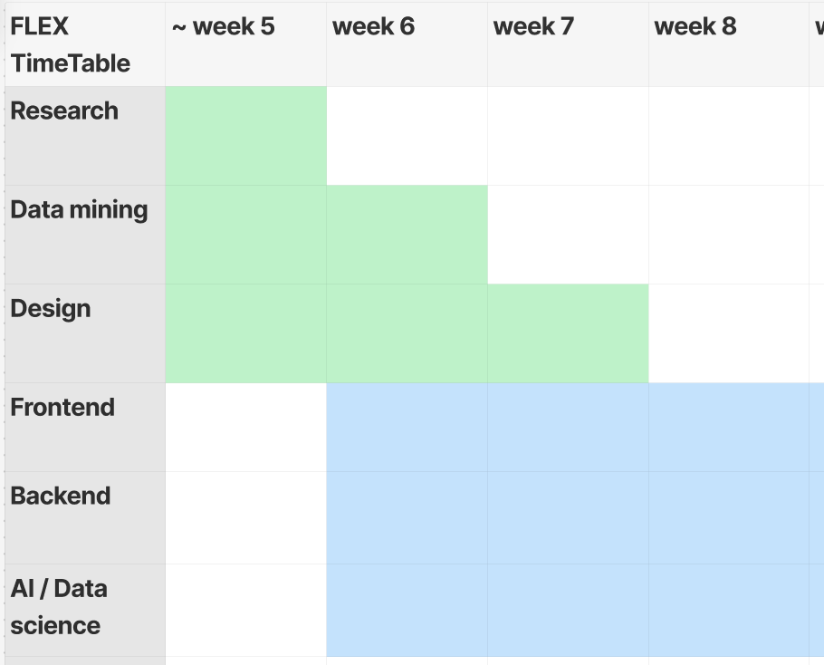
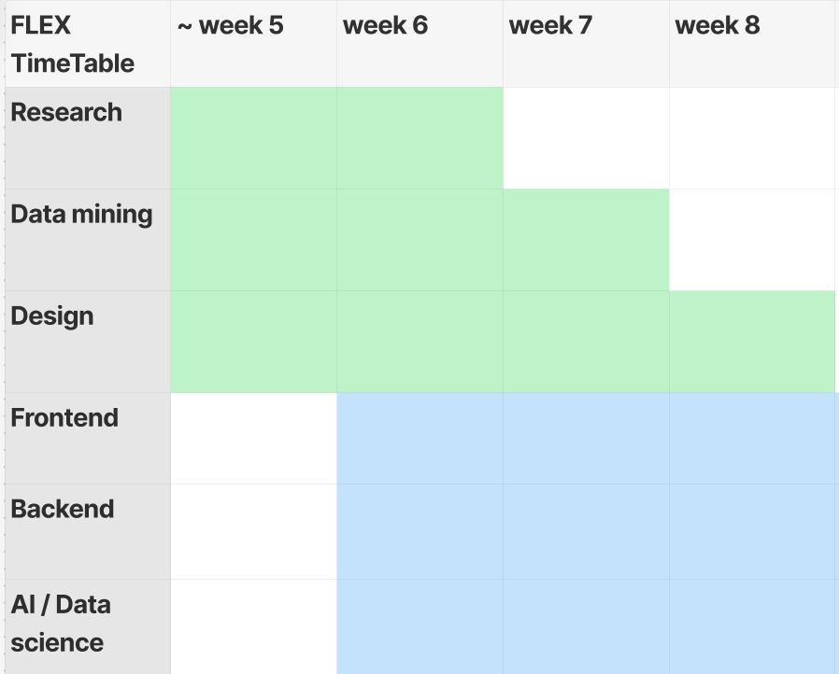
Overall Progress
We encountered conflicts as we aimed to refine our development process towards a more effective recommendation system, while also facing the limitations of a restricted dataset.
As a result, our schedule was delayed by a week.

Slide 5
02
Completed tasks

Slide 6
Tasks Completed This Week
Discussion of project topic based on the challenge
Analysis of existing research and design of modeling approach
Data collection
Preparation of frontend and backend environments & UI / UX design

Slide 7
03
Technical BackGround

Slide 8
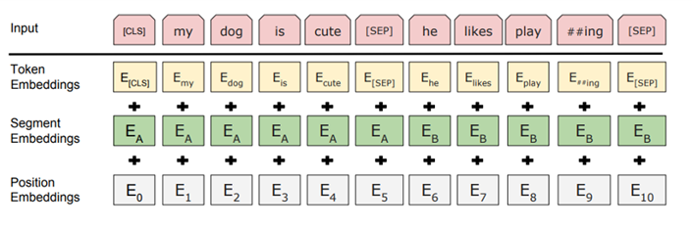
Technical Background
1. BERT
AI model for natural language processing.
We use this for transforming user’s input into the format of food data.

Slide 9
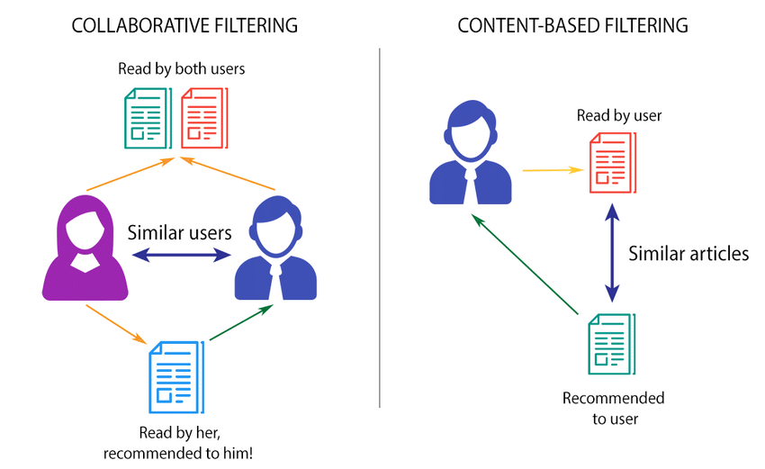
Technical Background
2. Collaborative Filtering & Content-based Filtering
Collaborative Filtering
Find similar user and recommend based on that user
Content-based Filtering
Find similar content based on user’s history
We use the idea of collaborative filtering for predicting new user’s preference about foods.
We also use content-based filtering for recommending food that user wants.

Slide 10
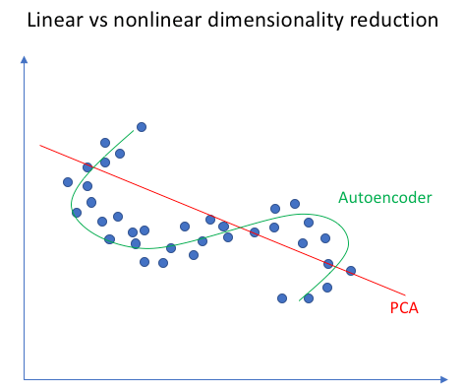
Technical Background
3. Dimension Reduction
Transformation of data from a high-dimensional space to a low-dimensional space.
Low-dimensional representation retains some meaningful properties of the original data.
We use nonlinear one in our project because the columns of food data have nonlinear relation.

Slide 11
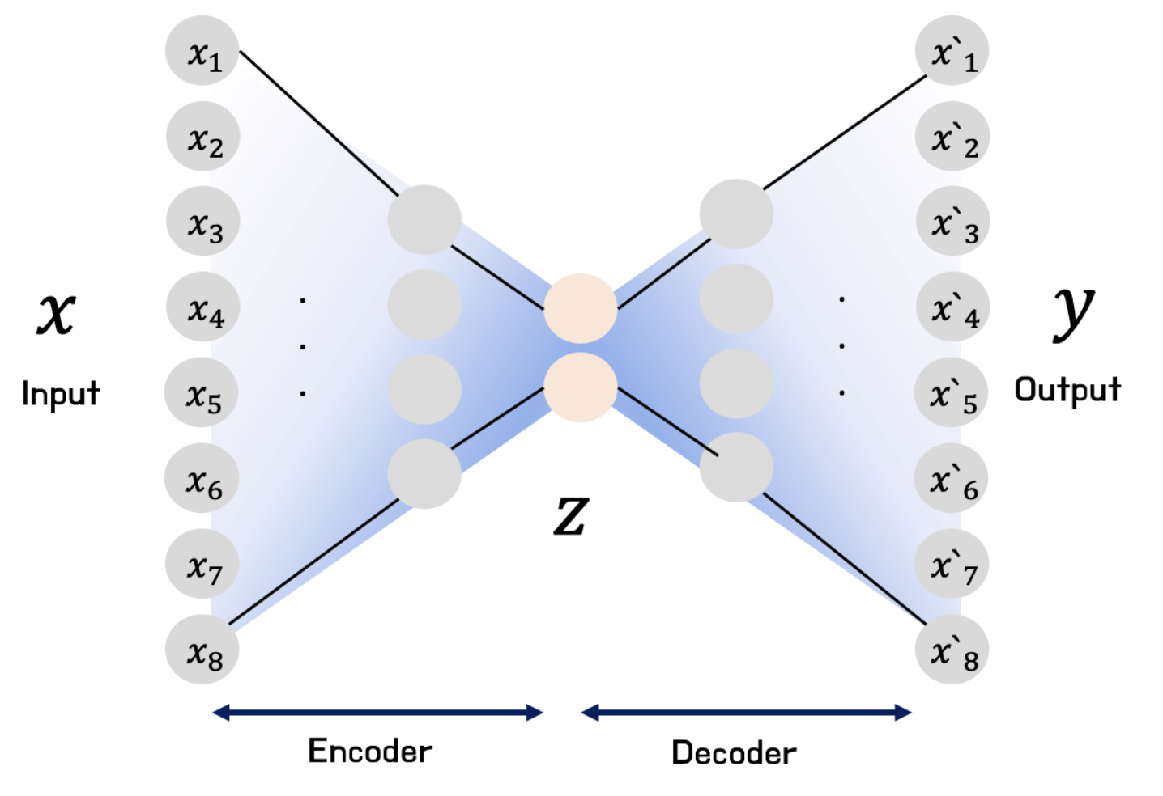
Technical Background
4. AutoEncoder
AI model for nonlinear dimension reduction
Encoder: Reduce dimension of input data and extract latent vector.
Decoder: Restore the compressed data into original dimension.
We use AutoEncoder for:
- reducing dimension of food data
- predicting new user’s preference about foods.

Slide 12
04
Project Challenge & Solution

Slide 13
Project Challenge 1
When calculating the nutritional content of food, quantity becomes the most important factor.
However, arbitrarily setting that quantity or expecting the user to consume the exact amount is unrealistic.
Solution: We have decided to exclude food components from the recommendation model. Instead, we will utilize a variety of features to improve the recommendation performance.

Slide 14
Project Challenge 2
If nutritional components are not applied in the food recommendations, it becomes impossible to recommend both food and exercise together. This is because exercise recommendations are calculated based on the nutrients that need to be consumed.
Solution: We decided to separate the food recommendation model from the exercise recommendation model. We will develop an algorithm that recommends food based on user preferences and another that suggests workout routines based on the food the user has consumed.

Slide 15
Then, what sets this system apart from existing recommendation systems?
Why is AI necessary for this project?

Slide 16
Hybrid Model of Content-Based Filtering and Collaborative Filtering
We will use a method that first measures the similarity between food items to select n foods. Then, by measuring the similarity between users, we will identify the most preferred food among the selected n items. This approach combines content similarity to narrow down food options and user similarity to make the final recommendation based on preferences.

Slide 17
Then, what sets this system apart from existing recommendation systems?
Why is AI necessary for this project?

Slide 18
Prediction of personal food preference scores using an autoencoder.
AI is essential for this project because deep learning models are being increasingly researched for recommendation systems. We aim to apply these models to collaborative filtering. Instead of using traditional clustering methods to find similar users, we will use an autoencoder designed for reconstruction to predict preference scores for individuals lacking information.
This approach allows us to capture the non-linear patterns between the foods that users prefer, which we expect will enhance the accuracy and depth of our recommendations.

Slide 19
Dimensionality reduction vector generation derived from contextual understanding using BERT
To enable more diverse and detailed user preferences for food, we included not only preference scores but also recipe details, food origin, ingredients, flavor, and allergy information. For example, users can specify preferences like "I want bean sprouts, but they should be stir-fried."
This makes AI's understanding of context a critical factor in the project. Additionally, as the number of features increases, so does the dimensionality. Thus, the need for dimensionality reduction using the latent vector from an autoencoder became essential.

Slide 20
05
Data Mining , Frontend & Backend setup

Slide 21
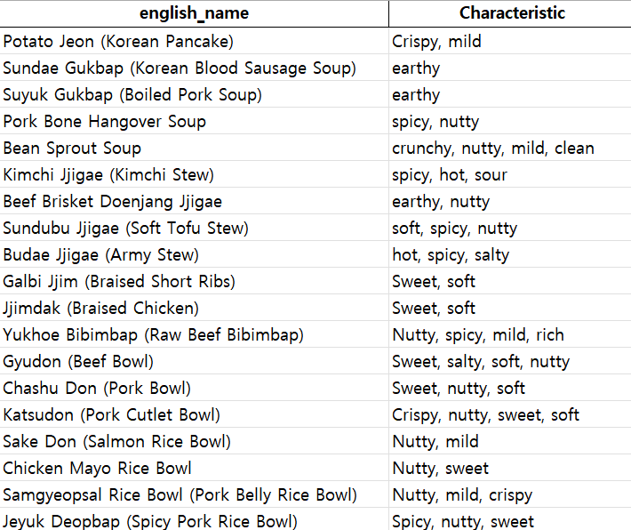
Data collection
1. Food Selection & Web Search
Selected 90 foods that are accessible near SKKU, Suwon.
Web Search for each foods’ characteristics.

Slide 22
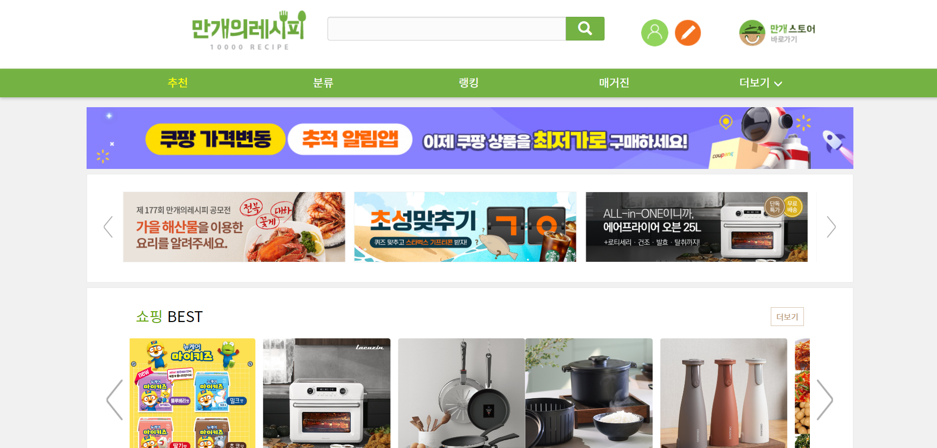
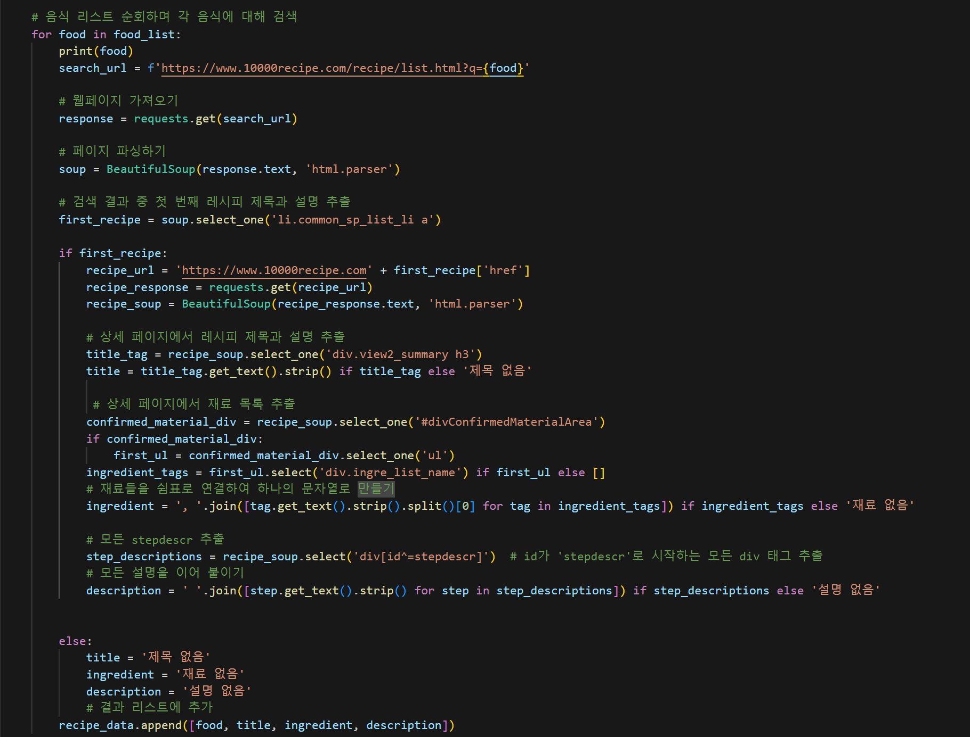
Data collection
2. Web Crawling
Web Crawling for foods’ ingredients and recipes.

Slide 23
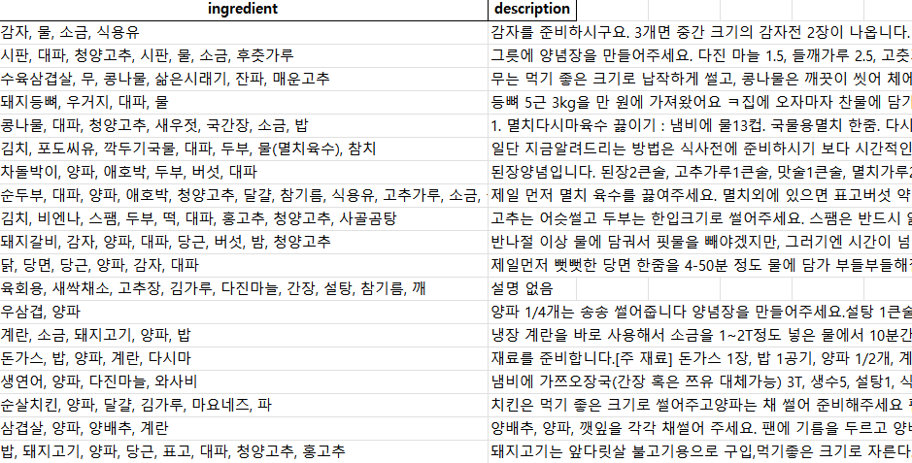
Data collection
2. Web Crawling

Slide 24
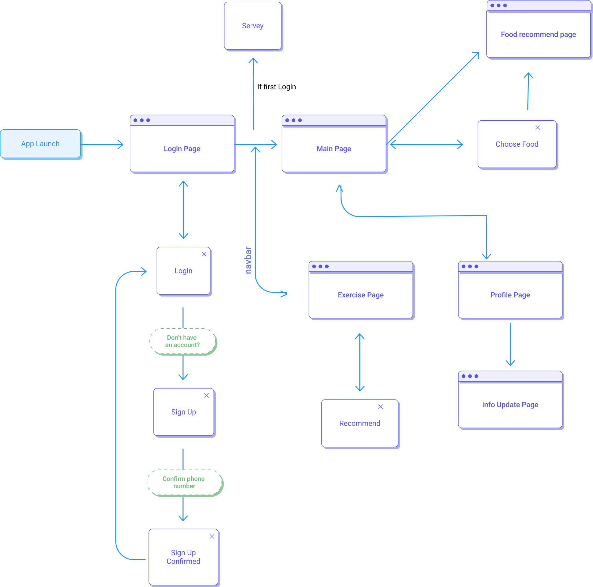





UI / UX design & Frontend setup
Initial settings
Rules
Userflow
Make initial settings for React Native Develop
Set version (Node, React..,)
Set contribution guidelines, Code Style Guide
Make Userflow for design.
Notes:
Initial settings =

Slide 25

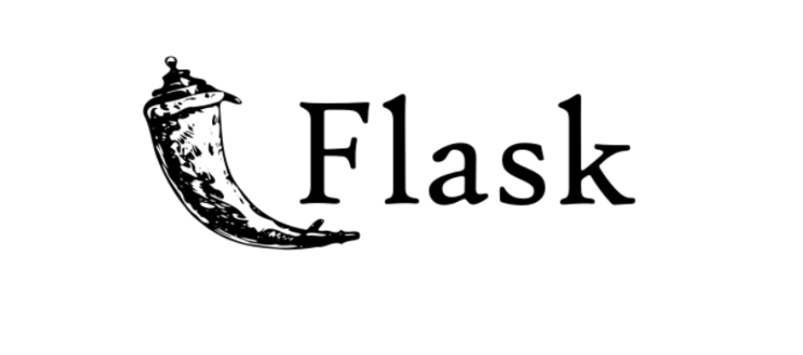
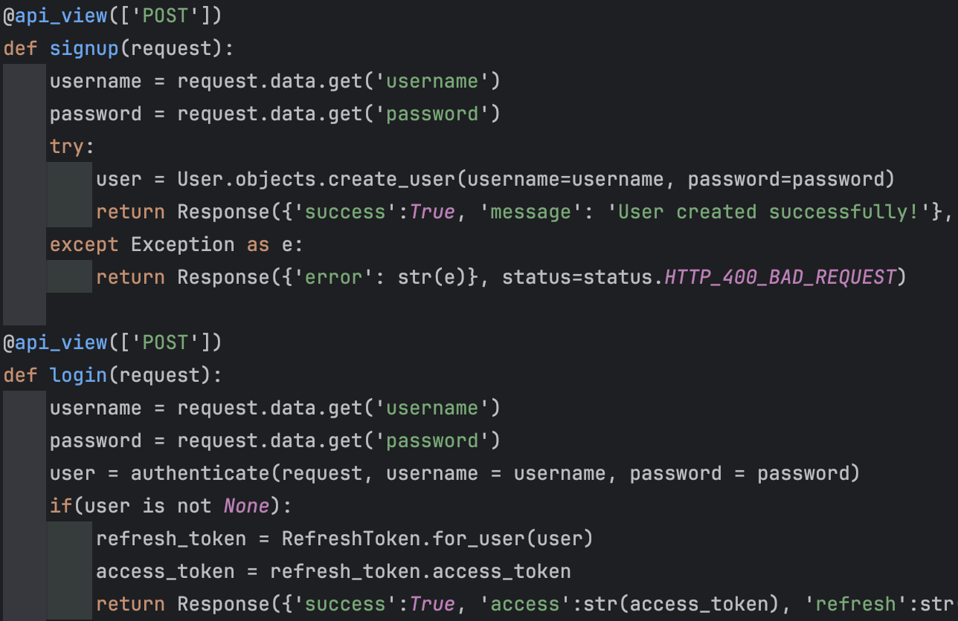
Backend setup
Initial settings
Database setting
Basic Login / Sign up logic for test
Make initial settings for Django in virtual environment
Make database in locally with Flask
Make login / sign up process with JWT

Slide 26
06
Next week plan

Slide 27
Things to be done until next week
backend
AI
UI / UX & Frontend
Make API docs and ERD in detail.
Integrate login / sign up parts with frontend.
Workout recommend algorithm
Make NLP Model
Complete UI/UX design for all pages
Make login/ sign up parts and integrate with server
Connect with Foodlens API

Slide 28
THANK YOU

